Slide 1
Analyzing Customer Churn
File created on: 3/22/2024 7:48:59 PM

Slide 2
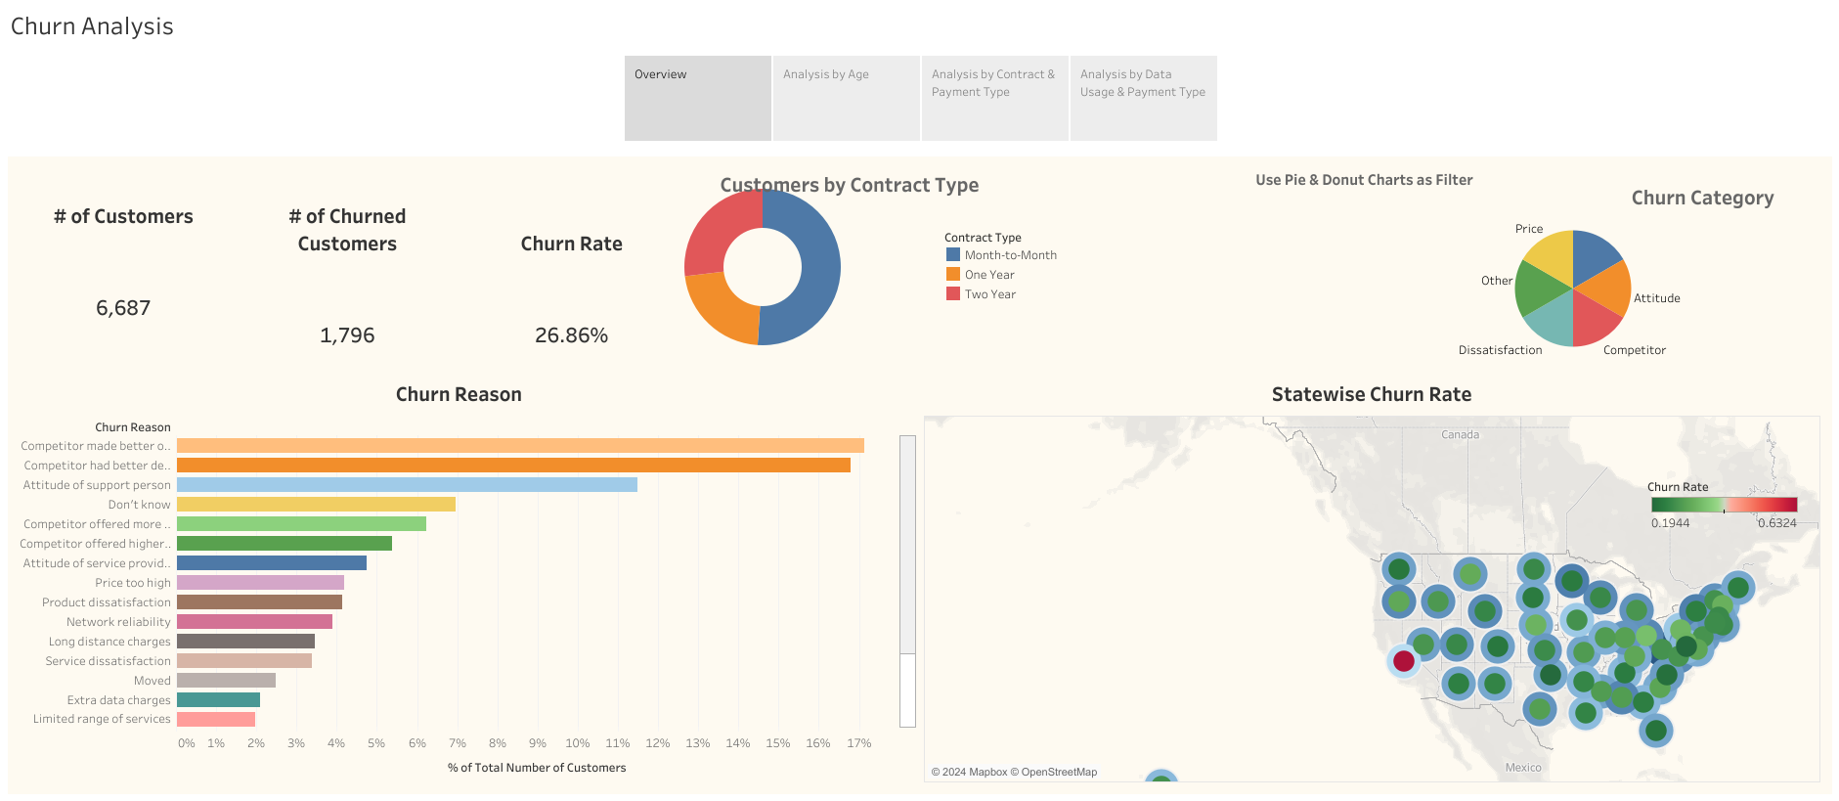

Slide 3
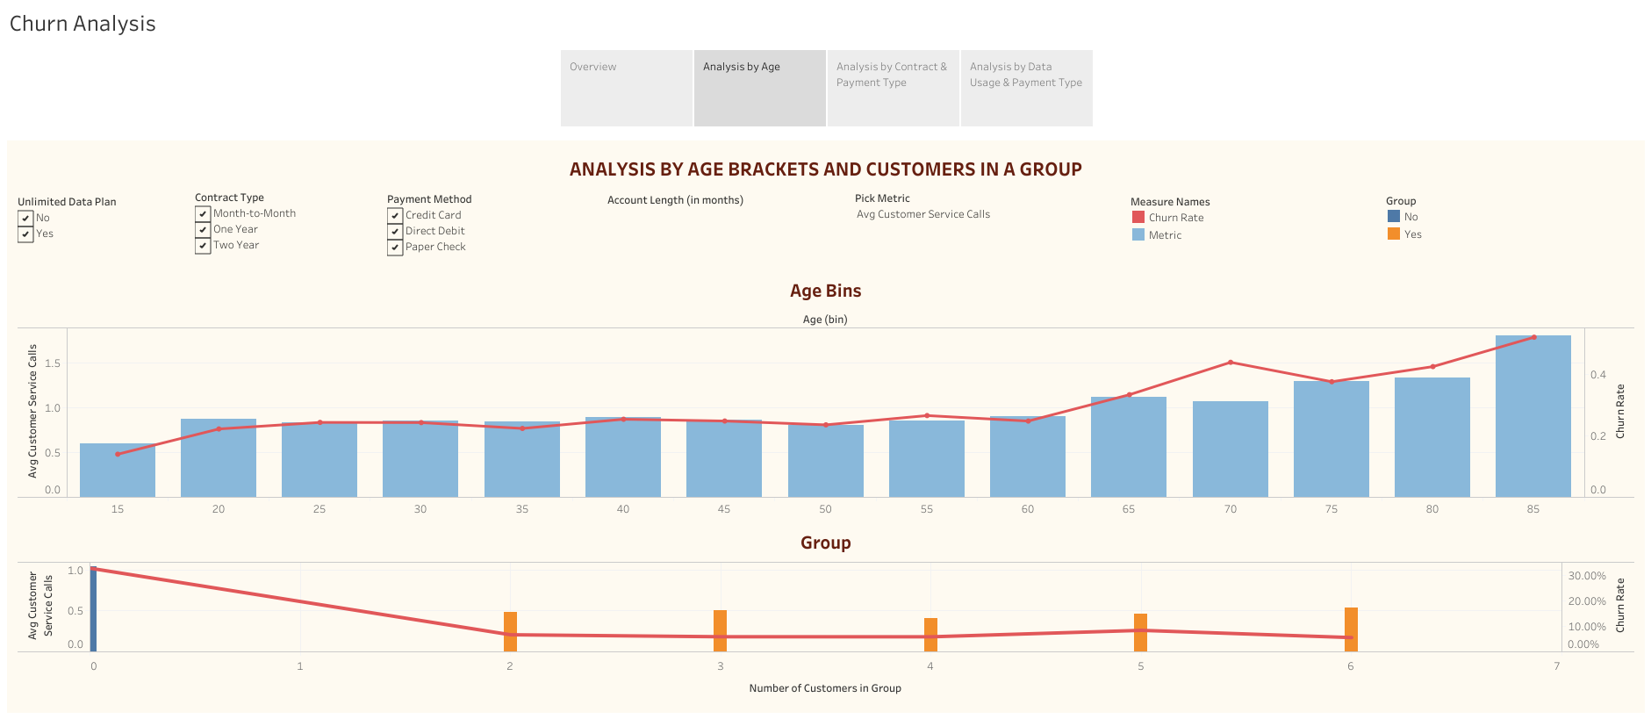

Slide 4
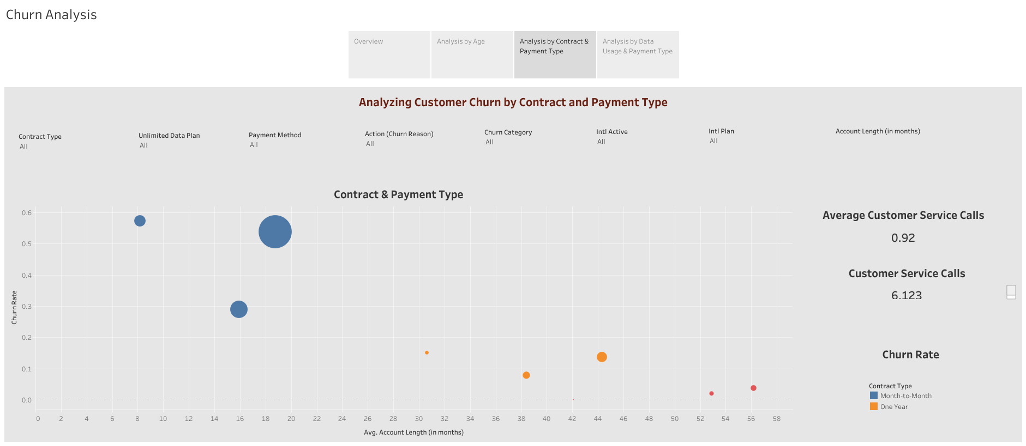

Slide 5
